Slide 1


The Violence Reduction Unit’s Community Grants Scheme 2026

Slide 2
Session Overview
Outcomes:
To introduce the VRU Community Grants Scheme
To increase understanding of the application process and scheme requirements
Session Structure
Introduction to the VRU and SYMCA
Scheme Overview
Application Process
Common Errors and Top Tips
Q&A

Slide 3
1. Introduction to the VRU and SYMCA

Slide 4
Role of the VRU And South Yorkshire
Mayoral Combined Authority (SYMCA)
Aim: To support our communities to work together to prevent and reduce violence and support the MCA's Corporate Plan to build a wealthier, healthier, happier and safer South Yorkshire.
Established in 2019 with funding from the Home Office secured until 2027.
The VRU and Policing and Reform
  We sit within the Policing and Reform Directorate in the MCA
  Accountable to Violence Reduction Executive Board and the Home Office
  The VRU has its own priorities in addition to those in the Police & Crime plan.
  Based with the MCA the VRU has influence on skills, education, housing etc, which all impact violence
Take a public health approach:
  Needs of populations (rather than individuals)
  Understand and address the causes of the causes of violence
  Intelligent use of data and our evidence base
  Partnership working across organisations and communities

Slide 5
General Overview
The VRU community grant scheme has been running since 2019 to enable non-profit organisations to deliver community-based projects aimed at keeping people safe, tackling crime and anti-social behaviour, and supporting victims of crime.
Since 2019 we have:
  Awarded 217 community grants
  Provided over £2.9 million in funding to community organisations across South Yorkshire
  Supported over 30,000 people through these funded projects
The VRU will fund projects within each of the local authority areas.
The fund is heavily subscribed. In 2025, the VRU received 127 applications and 22 were successful.

Slide 6
2. Scheme Overview

Slide 7
Funding Overview
Deadline: Applications open 1st June and close 12pm (midday) 26th June 2026
Funding period: 1st October 2026 – 30th September 2027
Award value: No lower limit up to £20,000 max. We welcome application bids for smaller awards.
Payment structure:
Instalment | Date | Percentage
1st Payment | 01/10/2026 | 25% of grant award
2nd Payment | 12/01/2027 | 25% of grant total / or actuals based on spend (up to 50%)
3rd Payment | 13/04/2027 | 25% of grant total / or actuals based on spend
Final Payment | 12/10/2027 | Final payment based on actuals.

Slide 8
Who We Fund
Non-profit organisations delivering in South Yorkshire including:
  Registered charities
  Community interest companies
  Voluntary organisations
  Unregistered charities
  Schools and trusts (delivering non-statutory activities additional to the National Curriculum and standard school day)
We do not fund NHS bodies, prisons, or local government bodies, including councils at all levels. We do not fund businesses or profit-making enterprises.

Slide 9
Who We Fund
All organisations must have the following governance arrangements in place:
Requirement | Details
An established Governing Body i.e. Board of Trustees or Directors | Must have a minimum of 3 members including 1 independent member* Must meet at regular points throughout the year
A Governing Document i.e. constitution, memorandum of articles, trust deeds, etc. | This governing document must clearly state: Organisation is not for profit and has a clear purpose and/or objectives Dissolution clause/asset lock in place in the instance of closure
Financial management arrangements | Bank account in organisation’s name Financial transactions and payments must be reviewed by 2 unrelated payment authorisers
Safeguarding policy and procedures | Up-to-date policy in the applicant organisation’s own name with effective implementation and monitoring arrangements Appropriate, regular training arrangements for staff and volunteers All staff and volunteers with direct access to children, young people and vulnerable adults subject to DBS background checks Clear steps in the event of an incident or concern Named safeguarding representative within the organisation
Adequate insurance levels | Employers Liability Public Liability Professional Indemnity (where applicable to the project proposed)

Slide 10
What We Fund
Activities should align to the VRU’s priorities and 5 key themes:
  Reducing / Preventing Knife Crime
  Reducing Violence Against Women and Girls, targeted at those under 25.
  Coaching and Mentoring to Reduce Violence
  Diversionary activities away from violent crime
  Racial Disproportionality in Serious Youth Violence
Support for South Yorkshire residents and communities
Activities in South Yorkshire
Activities which help address an identified or unmet need
Links in with local partners and provision
Eligible expenditure and value for money (budget and eligibility are discussed later in this presentation)

Slide 11

Types of Projects
Innovative and/or proven methodologies*:
  New ideas and/or activities i.e. pilots/trials
  Established models that engage new audiences
  and places
3 categories:
  Preventative
  Supportive
  Responsive
*Please refer to the YEF Toolkit for a breakdown of proven methodologies Youth Endowment Fund Toolkit

Slide 12
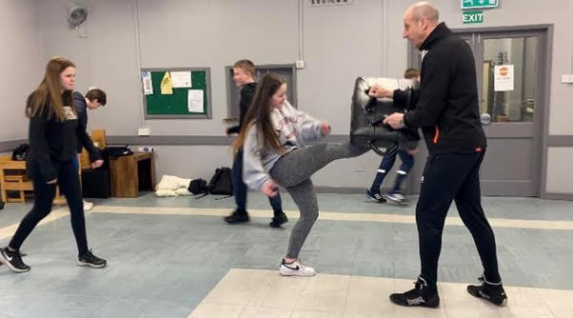
Preventative Projects
Types
Education and training to encourage positive development and manage behaviours
Diversionary activities to divert young people away from crime and ASB such as sports, arts, music, media, technology, youth work, social action and environmental/gardening.
Activities designed to change behaviours, reduce risk factors, and break down barriers

Slide 13
Supportive Projects
Peer Support and Talking Therapies
Peer and professional support to divert people away from crime
Mentoring Projects
Mentoring and diversionary activities for people at risk of:
  Exclusion from school; or
  Involvement in serious crime and ASB
Specialist Support
Support for groups including care leavers, victims of crime, LGBTQIA+, Black and Minority Ethnic Groups
Therapeutic interventions for children and families, e.g. trauma therapies
Caseworkers to support specific targeted groups
Training such as anger management, employability, cyber safety, etc
Activity Based, e.g. sports, arts, media, environmental, etc.
Drama projects for women and children who’ve experienced forms of violence
Music and media projects for disadvantaged / at risk young people

Slide 14
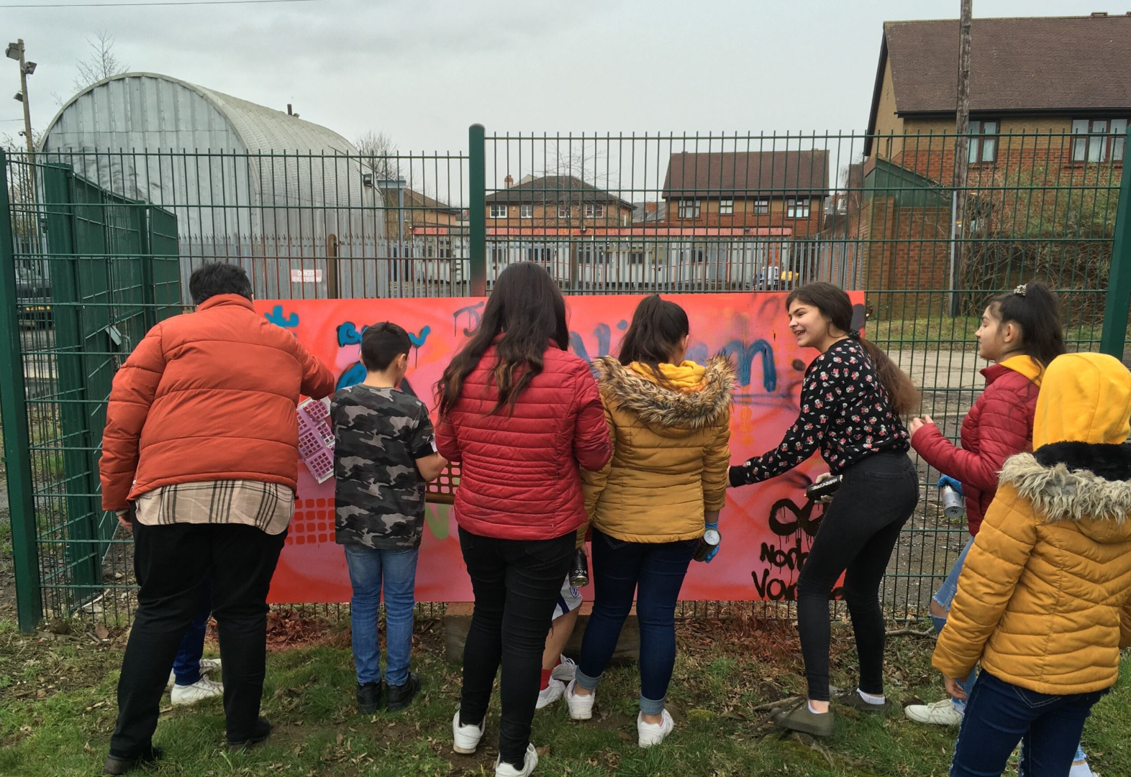
Responsive Projects
Types
Awareness raising and educational activities identified in the VRU’s priorities
Community based activities that address and respond to local priorities and needs
Examples
Knife Crime
Violence against Women and Girls
Projects to raise awareness of issues such as hate crime and cyber-crime

Slide 15
Project Locations and Activities
While delivery in specific areas is not a prerequisite for successful funding, the VRU would particularly welcome projects and interventions in areas of need.
Details of these locations, and suggested activity focus are documented on pages 5 and 6 of the Grant Guidance Notes, e.g. Barnsley:
Area
Barnsley Central
Worsbrough Common
Hoyland
Suggested activity focus:
Outreach activities / detached youth work
Street based preventative worker akin to a “Street Navigator” – targeting children involved in drug use and engaging them at street level and supporting them into support.
Engagement at street level to reduce prevalence of violence within the town centre

Slide 16
3. The Application Process

Slide 17
Application Process
Apply via email to Grants@southyorkshire-ca.gov.uk
Word application form, downloaded from the VRU website
  Please do not amend or convert the document to any other formats
  The application form must be submitted to the VRU in Word format (we cannot accept pages or PDF documents)
No more than one application can be submitted per organisation/project lead, and we are unable to accept attachments.
Please ensure applications are sent before the cut off time, late applications will not be reviewed
Please review all guidance documents and FAQs provided on the VRU Website, these detail all the key information relevant to the grant fund.

Slide 18
Application Timeline
We opened for applications on June 1st and will close midday June 26th.
Please note that the dates below are provisional and may change if any unforeseen delays arise.
Application Deadline | Panel Meeting | Provisional Notification | Project Start Date | Project End Date
Friday 26th June Noon | Mid-July | Mid-August | 1st October 2026 | 30th September 2027

Slide 19
Themes, Priorities and Approaches
Theme: Applicants MUST select at least 1 theme (select all that apply).
Priorities: Applicants MUST select at least 1 priority (select all that apply).
Approaches: Select only those applicable (this is not a requirement for funding).
How will your project contribute to the priorities you have selected above?
  How will the project break down barriers or reduce risk factors?
  How will it help victims to recover from crime?
  How will it reduce the likelihood of groups becoming victims of crime?
  How will it divert groups away from involvement in crime?

Slide 20
About the Project
What activities are you proposing to deliver using the grant?
  What are the project aims and objectives? (Q5)
  Who will benefit from the project (age, gender, ward, etc.) and how will they be identified, recruited and engaged?
  What activities will be delivered using the grant? (Q8)
  How is the activity or initiative different to, or in addition to, what already exists? (Q6)
Specify anticipated number of beneficiaries
Specify number of sessions (where applicable)

Slide 21
Project Need: Why is this project
needed?
How do you know it's needed? How has the need been identified? (Q7)
  Consultation with the public or service users
  Previous experience or local knowledge
  Reviewed Area/Ward Profiles or JSNA
  Reviewed crime data: SYP website
How will your proposed project address this need? Why is it the right approach to use?
  How do you know it will be effective?
  How do you know it will work?
  Have you got evidence to show that this type of intervention has worked before?
  Please refer to the YEF Toolkit for a breakdown of proven methodologies Youth Endowment Fund Toolkit

Slide 22
Partnership Working
How will you work in partnership with South Yorkshire Police, the public sector and/or other organisations to deliver this project? (Q9)
  Referrals into the project or onto other provision
  How will you join up working arrangements and what do you already have in place?
  Joined up working arrangements
  Delivery of specialist subjects or sessions
What organisations do you plan to work with and what is their role?
  Name the organisations / institutions
  Describe their role and / or contribution
  Have they been contacted and agreed to support the project?

Slide 23
Measuring Success - (Q12)
Qualitative and quantitative metrics:
  Quantitative: fixed, number-based, measurable
  Qualitative: provides meaning and insight, subjective, text based i.e. Case studies, service user surveys or evaluation groups, feedback sessions.
Total number of referrals to support services
Number of referrals broke down by referral source
Number of individuals supported in the time period
Number of new individuals supported
Retention rates
Population data (age, gender, ethnicity, etc.)
Provision of case studies or qualitative data
We are providing an evaluation tool this year. This is based on the last 3 years of work by Rocket Science.
The Evaluation Tool should be used unless there is a justifiable reason not to.
The Evaluation Tool should be aimed to be given twice; close to the beginning of involvement, and close to the end.

Slide 24
Impact & Exit Plan (Q11)
What is your plan for sustaining the activity or impact of the project when the funding ends?
Consider the following:
Sustaining the impact i.e. what happens when the grant ends
Sharing and/or embedding lessons learned
Continuation of services i.e. what happens when the grant ends (continuity of service going forward)
Building on relationships developed during the funding period
What positive changes will happen to the project participants because of taking part in the project? How will the project benefit the wider community?
Examples
Progression into education, employment, training, or volunteering
Progression into other provision e.g. grassroots sports, etc.
Improved interpersonal and social skills e.g. confidence, communication, relationships, etc.
Better outcomes i.e. attendance, attainment, participation, motivation, etc.
Reduction in crime related incidents in the neighbourhood
Improved community cohesion

Slide 25
Preparing the Budget
Budget Headings
Employee | Transport
Premises | Promotional costs
Services & Supplies | Other costs
Check the budget adds up
Ensure large funding items are clearly itemised
Where our funding contributes to a larger pot, ensure it is clear what we would be funding
Include your calculations hourly rates, unit prices, numbers, frequency, etc
Work with your Finance Officer to confirm values
Ensure your offering value for money
Ensure the project is costed properly
Prepare in Excel if possible and keep a copy
Ensure all expenditure is eligible against guidelines

Slide 26
Eligible Expenditure
Cost Heading | Eligible Expenditure | Ineligible expenditure
Employees | Direct delivery costs Expenses for project volunteers | Unspecified and/or statutory costs
Premises | Room hire/facilities (external to the organisation’s premises) We may cover ongoing costs such as rent and utilities | CCTV, security alarms Capital/building costs Use of organisation’s own facilities
Transport | Public transport, car mileage and minibus hire | Purchase minibuses Transport outside of South Yorkshire
Supplies & Services | Structured activities aligned to VRU priorities inc. trips and visits Equipment for the activity | Personal clothing (kits) for established groups Grants primarily focused on the purchase of equipment Activities outside of South Yorkshire Capital expenditure, e.g. fixed gym equipment
Promotions & Events | Publicity materials
Other | Direct project costs inc. DBS costs Management/admin: 10% max. | Evaluation/feasibility studies Membership fees/subscriptions 3rd party grant making

Slide 27
Assessment
Quality Criteria
Clear and well-defined aims with evidence of supporting our communities
Evidence of need
Ability to budget and deliver within guidelines
Confidence in ability to deliver
Strength of partnership working
Cost effective budget / eligible items for funding
Process
Scored by a panel with representatives from the VRU, Policing and Crime, SYMCA, Local Authorities, South Yorkshire Police and Community Representation
Scored against a Matrix ranging from 0 (unacceptable) to 5 (excellent)
Clarification questions may be asked.
Due diligence checks are undertaken for all successful applicants.

Slide 28
Grant Award and Reporting
Reporting requirements
1st Return – January 2027
2nd Return – April 2027
3rd Return – July 2027
Final Return – October 2027
Grant management meeting / visits
Payment Schedule
25% upfront at launch
25% in January, based on successful monitoring returns
25% in April, based on successful monitoring returns
25% in October, based on actual spends and successful monitoring returns
Submission requirements
Completed monitoring forms
Proof of expenditure
Deadlines in Grant Agreement

Slide 29
4. Common Errors and Top Tips

Slide 30
Common Errors:
Insufficient Detail
Alignment to VRU themes or priorities
Delivery methodology
Time line or project plan
Referral pathways (into and beyond)
Beneficiary targeting
Evidence of need
Partnership arrangements
Mitigations

Slide 31
Common Errors:
Budgetary Issues
Ineligible expenditure
  Trips or activity outside South Yorkshire (Inc Peak District)
  Project / management costs above 10%
  Evaluation costs
  Activities which are not educational, i.e. trips to the cinema, ice skating etc
  Hiring out your own venues / locations
Imbalances
Line items not itemised
Unrealistic costs
Costs which are not aligned or mentioned in the main bid

Slide 32
Top Tips 1
Developing the project
Carefully read the scheme documentation to ensure suitability and eligibility
Engage internal colleagues to secure buy-in and assistance
Allocate plenty of time
Engage with partner organisations to gain their support, especially if they are making or receiving referrals
Consider your plans for when the funding ends
If you’re unsure of anything, contact us

Slide 33
Top Tips 2
Writing your proposal
Adhere to word and character limits
Draft in Microsoft Word and copy across
Do not submit as a PDF document, and please do not alter the structure or formatting of the template
Be clear and concise
Check spellings and grammar
Avoid jargon, generalisations and abbreviations
Regularly refer back to the guidelines and documentation
Ensure you clearly describe how the project meets the priority and theme selected
Make a solid case to demonstrate the need for the project
Be specific: remember to include numbers, ages, locations, etc.
Have you covered the who, when, where, how and why?
Ensure you document the experience and qualifications, where applicable, of those delivering the project

Slide 34
Top Tips 3
Preparing your budget
Think value for money - £20,000 is a limit not a target
Ensure all items requested are eligible by checking the budget guidance
Ensure your budget is accurate, adds up and is itemised
Ensure you utilise the budget checklist in the guidance notes
Final checks
If you have time, walk away and review again later
Make time to proofread your proposal
Give yourself plenty of time to submit

Slide 35
Wider Support / Resources
Sheffield
Voluntary Action Sheffield - www.vas.org.uk
Rotherham
Voluntary Action Rotherham – www.varotherham.org.uk
Doncaster
Voluntary Action Doncaster – www.voluntaryactiondoncaster.org.uk
Barnsley
Barnsley CVS – www.barnsleycvs.org.uk
South Yorkshire Funding Advice Bureau – www.syfab.org.uk

Slide 36
For all questions and to submit your application: Grants@southyorkshire-ca.gov.uk

Slide 37
Rocket Science Workshop
Our current evaluation partner Rocket Science is delivering a free online workshop for voluntary and community sector organisations on developing your Story of Change.
A Story of Change is a practical way of explaining the difference your work aims to make. It helps you show the link between the needs or issues you are responding to, the activities you deliver, and the changes you hope to support for the people and communities you work with.
This session will be particularly useful for organisations applying to the next Violence Reduction Fund grants round, as it will help you think through how to clearly describe your project’s intended impact in your application. However, the session is not only about this grant round — the same approach can support future funding bids, partnership conversations, reporting, evaluation and internal learning.
The workshop is designed to be practical and accessible. You do not need previous evaluation experience, and you do not need to have a fully developed project idea before attending.
Please register here to attend: Rocket Science Workshop - Developing Your Story of Change – Fill in form

Slide 38
Questions?

