Slide 1
Developing your Story of Change
Explaining the difference your project aims to make
Violence Reduction Fund support session 10.06.26
Facilitated by Rocket Science

Slide 2

What we’ll cover today
By the end of this session, you should have:
  A clearer understanding of what a Story of Change is
  A practical structure for explaining how your work supports change
  Time to start applying this to your own project or project idea
  Ideas for how to use your Story of Change in funding applications, reporting and learning
Today’s session will include:
  What a Story of Change is
  Why it can help with funding applications
  The six building blocks of a Story of Change
  A worked example
  Two practical exercises
  Common pitfalls and how to avoid them

Slide 3
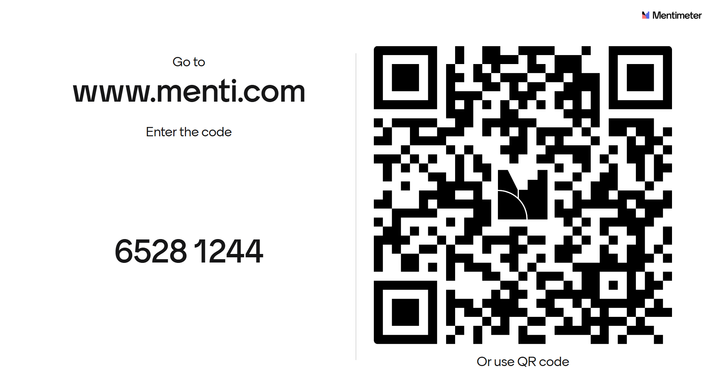
Menti placeholder

Slide 4
Why this matters
Funding applications often ask for your “impact”
But for many community projects, change can be:
  Gradual
  Relational
  Preventative
  Hard to measure quickly
  Different for different people
  Influenced by things outside your project’s control
A Story of Change helps you explain the steps between:
What you do → The difference you hope to make

Slide 5

What is a Story of Change?
A Story of Change is a clear explanation of how your project aims to make a difference
It connects:
  The need or issue you are responding to
  The people you are supporting
  The activities you will deliver
  How people engage with and experience the project
  The changes you hope to support
  How you might know and learn whether change is happening

Slide 6

What does a Story of Change do?
A Story of Change helps you answer…
  Why is this work needed?
  Who are you trying to support?
  What will you actually do?
  Why is your approach likely to help?
  What might change for people or communities?
  How will you know whether things are moving in the right direction?
→ It does not need to be complicated

Slide 7
Story of Change and funding applications
How this can strengthen your application
A clear Story of Change can help you explain:
  The need for your project
  Why your approach fits that need
  Who will benefit
  What changes you expect to support
  Why those changes are realistic
  How you will monitor, learn and adapt
→ It helps funders see the logic behind your project.

Slide 8

Avoid the “activity → big outcome” jump
Try not to jump straight from activities to big outcomes
Instead of…
“We will run youth sessions → violence will reduce”
Show the steps in between:
  Young people attend a safe, trusted space
  They build relationships with workers and peers
  They take part in positive activities
  They talk about needs, risks or concerns
  They access support or opportunities
  They spend more time in safer, positive environments
  Risk factors may reduce over time

Slide 9
Six building blocks of a Story of Change
Need
What issue, risk or opportunity are you responding to?
People
Who are you supporting, and what is important to understand about them?
Activities
What will you actually do?
Change
Evidence and learning
Engagement
How do people take part, and what should it feel like?
What short-, medium- or longer-term changes might happen?
How might you know, and how will you use what you learn?

Slide 10
Building block 1: Need
What issue, risk, challenge or opportunity is your project responding to?
You might think about:
  Safety and violence-related risks
  Lack of trusted support
  Social isolation
  Poor mental health or wellbeing
  Lack of positive activities or safe spaces
  Conflict in families, peer groups or communities
  Barriers to education, employment or support
  Low trust in services
Useful sentence starter:
“Our project is needed because…”

Slide 11
Building block 2: People
Who is your project trying to support?
Think about:
  Age group
  Local area
  Needs or risks
  Strengths and assets
  Barriers to support
  Relationships with family, peers, community or services
  Why your organisation is well placed to reach them
Useful sentence starter:
“We will work with…”

Slide 12
Building block 3: Activities
What will your project actually do?
Examples might include:
  Youth work
  Mentoring
  Sports, arts or creative activities
  Outreach
  Safe spaces
  Family support
  Conflict resolution
  Training or skills development
  Referral or service navigation
  Community events
Useful sentence starter:
“We will deliver…”

Slide 13
Building block 4: Engagement
This is often the missing link.
Ask:
How will people take part?
What helps them feel welcome or safe?
What helps build trust?
What makes them come back?
What should the project feel like for them?
What relationships or experiences matter?
Examples:
Young people feel listened to
Participants feel respected and not judged
Families feel supported
People attend regularly
People begin to talk about needs, risks or hopes
Useful sentence starter:
“Through taking part, people will experience…”

Slide 14
Building block 5: Change
What might change because of the project? Think about different levels of change.
Short-term changes
Increased trust
Improved confidence
Feeling listened to
Better awareness of support
Stronger relationships
Medium-term changes
Safer choices
Better access to support
Reduced isolation
Improved wellbeing
Increased engagement in positive activities
Longer-term changes
Reduced risk of involvement in violence
Improved safety
Stronger protective factors
More positive pathways
Stronger community resilience
Useful sentence starter:
“As a result, we hope…”

Slide 15
Building block 6: Evidence and learning
How might you know whether change is happening?
You might use:
  Attendance and engagement information
  Short feedback questions
  Conversations with participants
  Staff observations
  Case studies
  Partner feedback
  Referral or signposting outcomes
  Reflection logs
Useful sentence starter:
“We will learn whether this is happening by…”

Slide 16
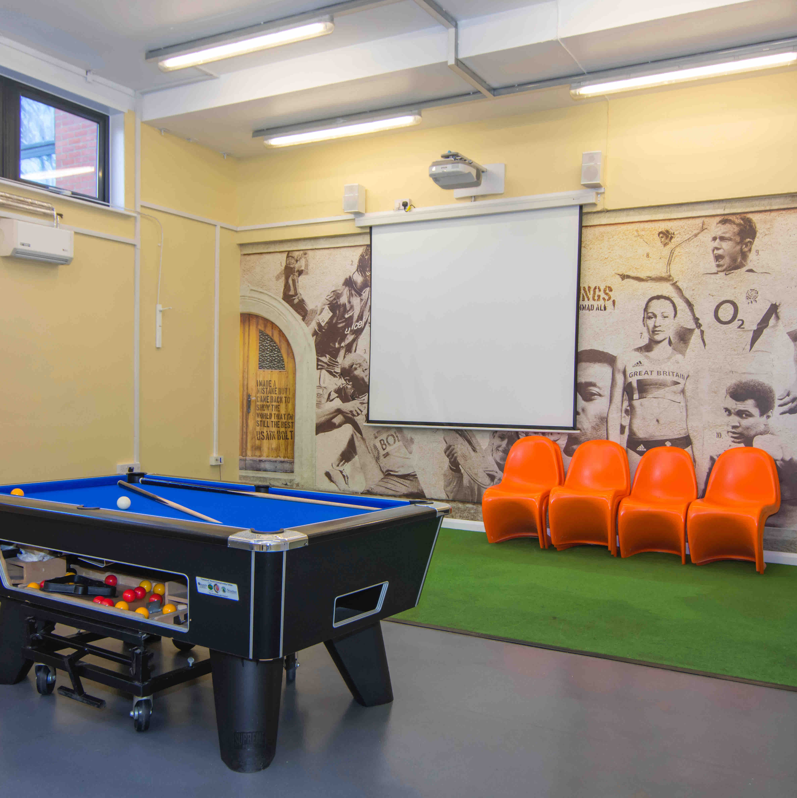
Worked example: youth safe space project
Need
Young people have limited safe spaces and may be exposed to risky situations.
People
Young people aged 11–18 in a local area.
Activities
Weekly youth sessions, mentoring, creative activities and signposting.
Engagement
Young people feel welcomed, build trust, attend regularly and talk to trusted adults.

Slide 17
Worked example: youth safe space project
Short-term change
Young people feel more confident, supported and aware of help available.
Medium-term change
Young people spend more time in positive activities, make safer choices and feel less isolated.
Longer-term change
Young people have stronger protective relationships and reduced risk of involvement in violence.
Evidence and learning
Attendance, short feedback questions, staff observations, case studies and partner feedback.

Slide 18
Exercise 1: A person’s journey through your project
Think about someone your project aims to support.
This can be a fictional person based on the people you work with.
Note down:
  What might be going on for them before they engage?
  What helps them take part?
  What do they experience through your project?
  What might start to change for them?
  What might still be difficult?

Slide 19
Why start with a person’s journey?
Thinking about a person’s journey can help you:
  Stay grounded in real experiences
  Avoid vague outcomes
  Think about what changes first
  Notice the importance of trust, safety and relationships
  Be realistic about what your project can influence
  Identify what evidence you might collect
→ A Story of Change should feel human, not just technical.

Slide 20
Feeding back: what are we noticing?
As we hear examples, listen for:
  What was happening for people before they engaged?
  What helped them take part?
  What seemed to change first?
  What might take longer?
  What might still be difficult or outside the project’s control?
Why this matters
These are the links between your activities and your outcomes.

Slide 21
From one person’s journey to your project story
A person’s journey helps us understand lived experience.
A project-level Story of Change helps us explain the wider logic of the project.
It brings together:
  The need across a group or community
  The activities your project will deliver
  The experience you want people to have
  The changes you hope to support
  The evidence and learning you will use

Slide 22
Exercise 2: Starting your Story of Change
Activity
Choose one project, service or project idea.
We’ll work through the six building blocks.
Don’t worry about perfect wording. Start with rough notes.
Need
What issue, risk or opportunity are you responding to?
People
Who are you supporting, and what is important to understand about them?
Activities
What will you actually do?
Change
Evidence and learning
Engagement
How do people take part, and what should it feel like?
What short-, medium- or longer-term changes might happen?
How might you know, and how will you use what you learn?

Slide 23
Prompts: need and people
Need
  What issue, risk or challenge are you responding to?
  Why is this important now?
  What do you know from your community, staff, partners or lived experience?
People
  Who will you work with?
  What barriers or risks might they face?
  What strengths, relationships or assets might they already have?
  Why is your organisation well placed to reach them?

Slide 24
Prompts: activities and engagement
Activities
  What will you deliver?
  How often?
  Where?
  With whom?
  What support, activities or opportunities will people receive?
Engagement
  Why would people take part?
  What would help them feel safe, respected or listened to?
  What helps build trust?
  What would make them come back?
  What should the experience feel like?

Slide 25
Prompts: change and evidence
Change
  What might change first?
  What might take longer?
  What changes are realistic for your project to influence?
  What bigger outcomes might your work contribute to?
Evidence
  What information could you collect simply?
  What feedback could participants give?
  What might staff observe?
  What could partners tell you?
  How will you use what you learn?

Slide 26

Common pitfalls to avoid
Try not to:
  Jump straight from activities to big outcomes
  Promise change your project cannot control
  List too many outcomes
  Use vague outcomes without explaining what they mean
  Forget the role of trust, safety and relationships
  Collect information you will not use
  Make the Story of Change too complicated

Slide 27
Making outcomes clearer
Instead of:
“Improve young people’s lives”
Try:
  Young people feel more confident asking for help
  Young people build trusted relationships with workers
  Young people attend positive activities regularly
  Young people report feeling safer in particular spaces
  Young people know where to go for support
  Young people have more positive plans for the future
→ Clearer outcomes make your Story of Change stronger

Slide 28
Using your Story of Change in a funding application
Your Story of Change can help you answer:
  Why is your project needed?
  Who will benefit?
  What will you deliver?
  What difference do you expect to make?
  Why is that change realistic?
  How will you know and learn?
→ A strong Story of Change helps funders understand the logic behind your project.

Slide 29
Key takeaways
Start with the need and the people you support.
Show the steps between your activities and the outcomes you hope for.
Be realistic about what your project can influence.
Think about evidence and learning from the start.

Slide 30

Close and next steps
Today’s slides and worksheet will be shared again after the session.
You can use your Story of Change to support:
  Violence Reduction Fund applications
  Future funding bids
  Conversations with partners
  Reporting and evaluation
  Internal reflection and learning
  Questions, thoughts, reflections…?

Slide 31
About Rocket Science
Rocket Science is a social purpose business, working towards a future where everyone can live healthy, happy, and fulfilling lives.
Our objectives are to help our clients reimagine systems, maximise investment to have the greatest impact and transform lifetime outcomes using a whole-person and prevention lens. We do this through research, mapping and analysis, evaluation and impact measurement, strategy and service design, participatory and peer research, learning, collaboration, and end to end fund management.
Please contact Ciaran McDonald for more information. ciaran.mcdonald@rocketsciencelab.co.uk
Edinburgh | London | Newcastle

